Slide 1



PowerCo SE
Case Study: Lessons learned and latest implementation results in digital battery passport and connectivity infrastructure.
Notes:
When we began implementing the battery passport at PowerCo we understimated the complexity. It turned out to be a challenge across structure, regulation, data and technology systems. We will share some of our learning today and are happy to exchange experiences afterwarsds as well.

Slide 2





Our vision: Become a global battery champion.
Setting standards
Competitive cell
performance & cost
Leader in
sustainability
Execution
in our DNA
1st address for global talent
Notes:
But before we start lets introduce powerco. Who we are and what we do.
Powerco was founded in 2022 as the VW group dedicated cell manufacturer, built around an unified cell concept.
Our strength is that we can produce different battery technologies in one stanardized production platform and make them later transparent through the battery passport.
Our ambition is to become the global battery champion by setting industry standards, whereby we focus on the pillars standardized manufcatuing, cell design, Sustainability with CO2 neutral factories.
What truly powers Powerco is ist people. We have a highly international team from more than 60 nations, and over 2K employees in total.
Minutes:
PowerCo established cell manufactuer for VW Group.
Founded in 2023 based on unified cell concept, and large scale standardized manufacturing.
Focus pillars: Standardized manufacturing, cell design and development sustainability in order to achieve this PowerCo aims to be the first address for global talent. Over 2K employees

Slide 3


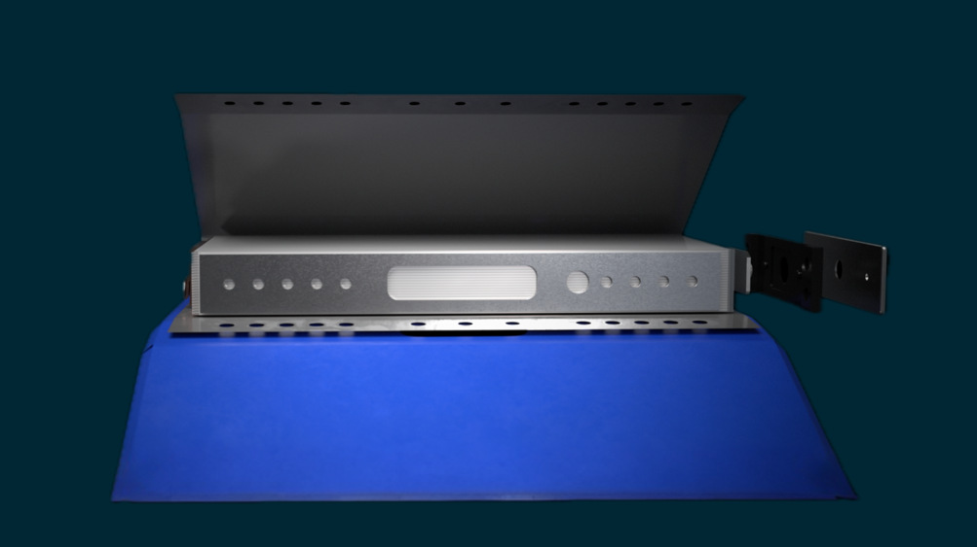

Highest Precision. Nothing less.
Notes:
On the top left you can see our focus product the unified cell. It is fully inhouse developed and tested according to highest automotive standarsd.
We aim with our UFC design to to have affordable, competitive and scalable products for all kinds of energy storage applications.
Focus product is our unified cell (top left). Which is fully inhoused developed and tested according to highest automotive standards.
PowerCo has the ability design test and analyse cells down to the smallest material level.
Goal: UFC Design to aim affordable, competitive & scalable product for energy storage applications.
Zum Inneren unseres ersten Produkts.
Nehmen wir die Anode: Die haben wir mit Fokus auf die Schnellladezeit optimiert, dabei aber auf den Rohstoff Silizium verzichtet. Das bringt einen Kostenvorteil, den wir an unsere Kunden weitergeben können.
Damit die Energie innerhalb der Zelle perfekt fließt und die Zelle lange hält, haben wir zudem einen speziell beschichteten Separator entwickelt.
Das alles wird durch präziseste Schweißtechnologien genau da verankert, wo es in der Zelle sein muss.
Jede Komponente sitzt passgenau.

Slide 4
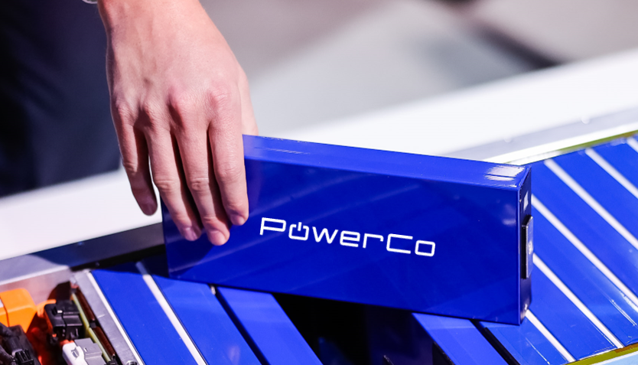

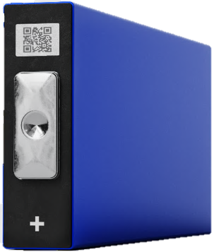


Product: UFC design. Low complexity, high standardization.
NMC
Nickel manganese
cobalt oxide
LMFP
Lithium manganese iron phosphate
NMC-Si Anode
Nickel manganese
cobalt oxide with silicon anode
MAIN
Passenger Cars
LFP
Lithium iron phosphate
Entry
BEST IN
CLASS
Trucks
Energy Storage
Systems
SSB/ASSB
Solid-state battery
Busses
SIB
Sodium Ion
CHEMISTRY
FLEXIBILITY
Adaptable to all leading chemistries, tailored to automotive segments
Economies of scale unlocking
cost advantages
Unique customer focus
resulting in shorter time-to-market
Notes:
The UFC concept is also designed to handle multiple battery chemistries on the same standardized production backbone.
The idea is low compleity in the factory and high standardization in the product.
Some of the chemistries include Sodim Ino, LFM for the entry. NMC for the main and Solid state for the Best in class
When we refer to entry main and best in class we mean different performance and cost levels.
Low cost = mass market. Main core volume segment. Best in class = Premium EV
Those can be than adopted for several application which are passanger cars, trucks, busses and ESS.
Deep Dive of differen chemical platforms are used in our cells. Entry Main and Best class.
Different characteristcs

Slide 5

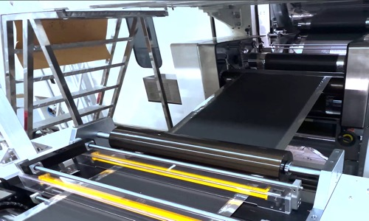
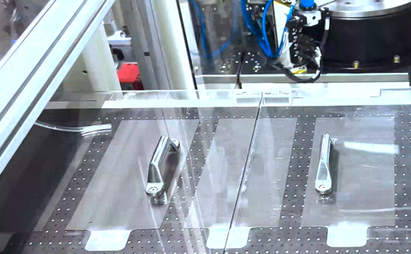
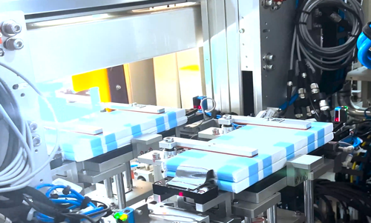
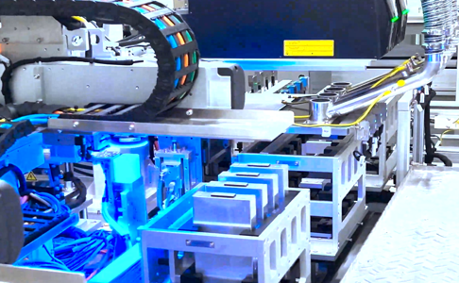

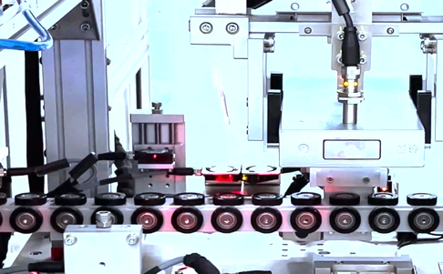
…execution in full swing.
1
2
Calendaring
Stacking
3
4
Assembly
Can closure
5
6
Einheitszelle links
Plasma cleaning
Wrapping
Notes:
Lets do a Short excursion to manufacturing and key processes which are
These processes generate most of the data we later need for the battery passport.
also relevant for data assembly of battery pass. To show adience where powerco stands in terms of execution.
1-6 important process steps.

Slide 6
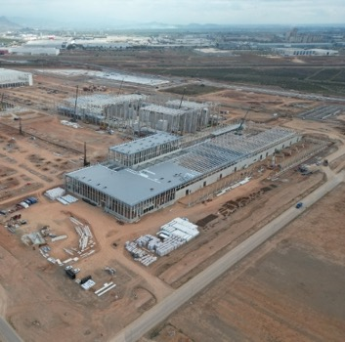

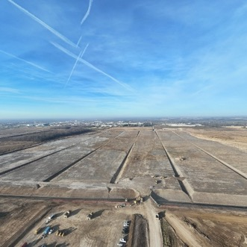






Global footprint enables competitive market access
Valencia
St. Thomas
Salzgitter
Dalian
Line Zero
Notes:
We are already operating international with different production plants.
Our major production plant is in SZ Germany, Valencia Spain and St Thomas
We also have a validation line in Dalian for production prototypes
Verschiende Fertiungsstandorte. Including China validation line. Prototype and validation lines in dalian to produce in short time prototypes. VA SOP 2027 St 2027. SZ live

Slide 7
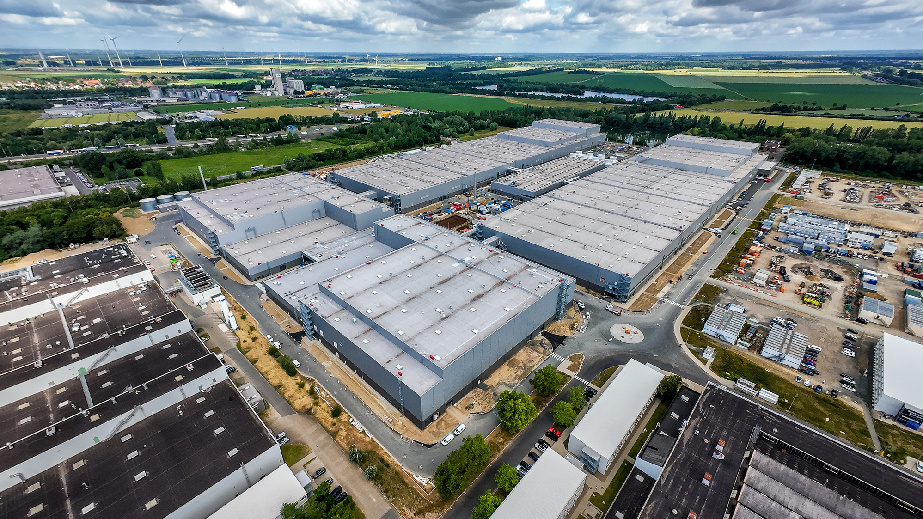
Gigafactory Salzgitter
Notes:
Some insights into ur gigafactory salzgitter. Its where sascha and me are based, near Braunschweig/Hannover.
Very excited to share that we started producing our first cells in Q4 last year and will go this year in full operation with our VW Group family.
In Salzgitter nehmen wir aktuell die ersten Bereiche in Betrieb.
Die ersten Zellen werden wir im vierten Quartal 2025 produzieren. Erstmals zum Einsatz kommen sie dann wie geplant im nächsten Jahr in der Electric Urban Car Family von Volkswagen, Skoda und Cupra.
Komplexität einer Zellfabrik wesentlich höher als bei Autofabrik.
Beispiel 1: Eigene Technik-Ebene über dem eigentlichen Fertigungsbereich, für Klimatechnik, Energie, Maschinensteuerung.
Beispiel 2: Brandschutz. Über 80.000 Sprenkler verbaut, fast das Dreifache der gesamten Motorenfabrik. Große Herausforderung, weil auch Behörden keine Erfahrung mit Zellfertigung haben. Anders als BER haben wir es aber gelöst, alle Genehmigungen liegen vor
Wichtig: Wir können Produktion, baugleiche Produktionslinie in Dalian bereits seit über einem Jahr im Betrieb.
➔ Video

Slide 8
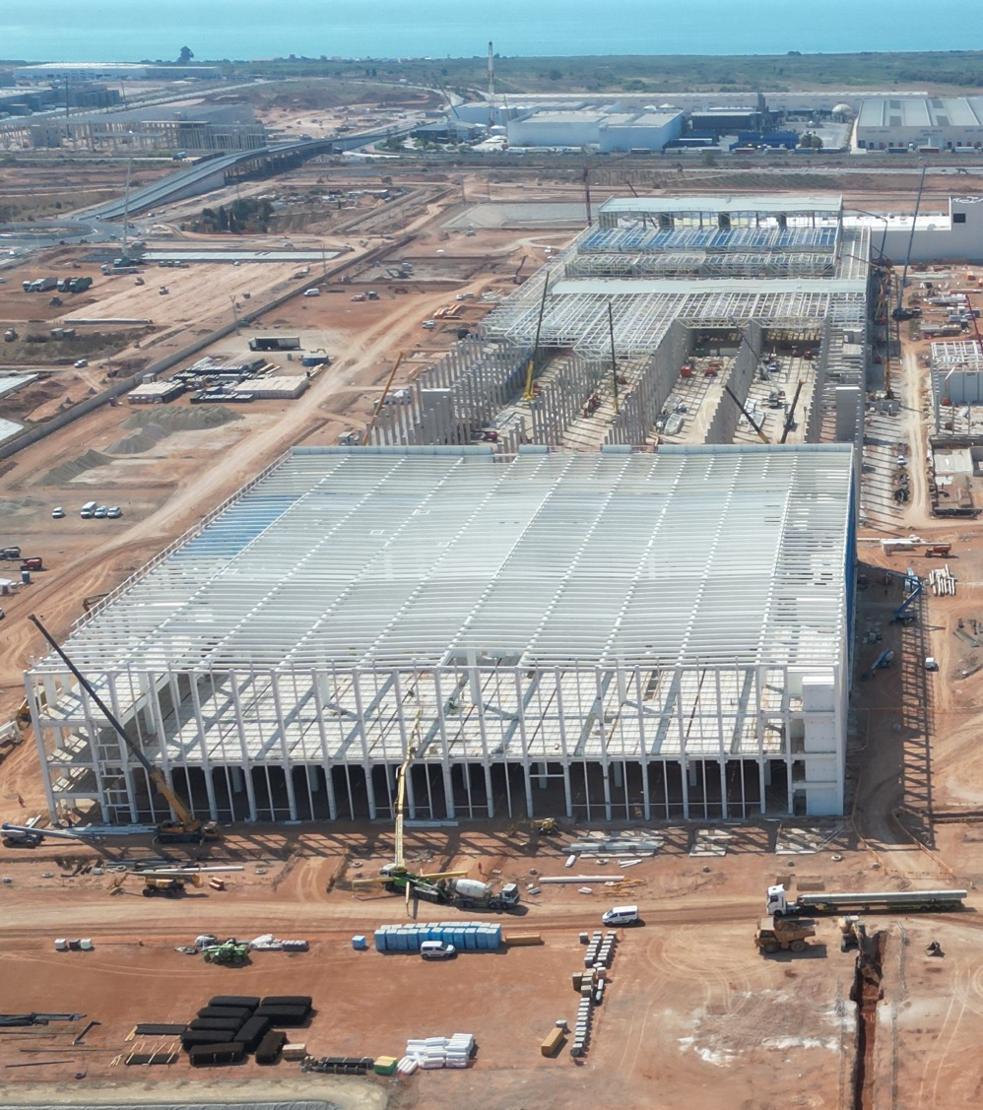
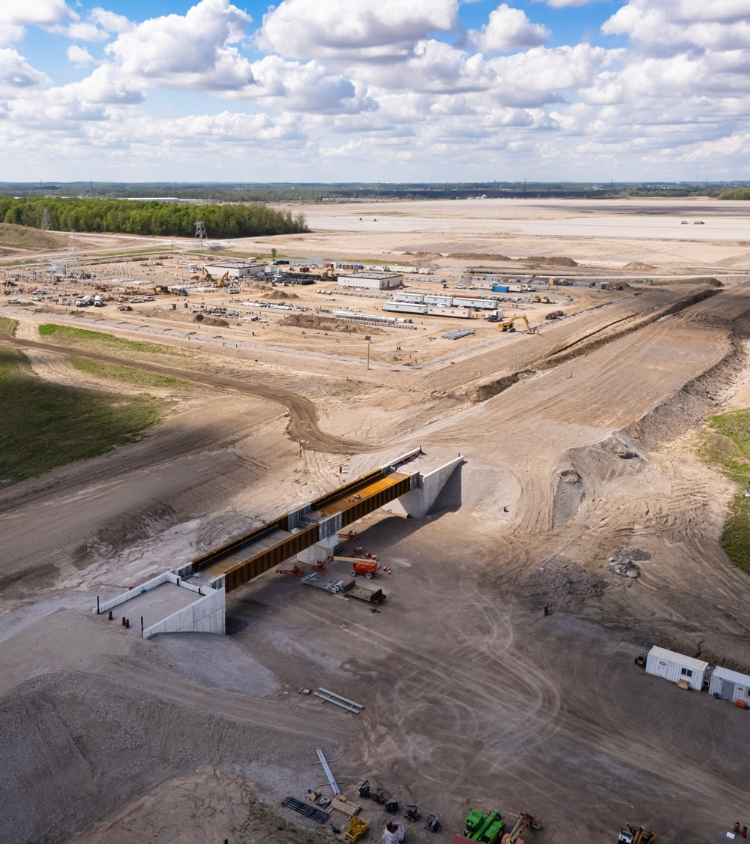
Gigafactory Valencia
Gigafactory St. Thomas
Notes:
If we look into our gigafactory valencia we have reached a major milestone in moving from construction to clean room production and will start with manfucaturing soon will planned SOP in 2027.
For St thomas we started with first steel installations in the last fall.
VA stahl konzutruition jetzt aussenhülle. TBC VA people
Stahlkonstruktion startet.

Slide 9
Practical Implementation Insights Battery Pass
PowerCo’s comprehensive 4 pillar journey of Battery Pass implementation
01
02
Structure & Organize
Understand Regulation
Build project governance, stakeholder alignment, and decision committees. Identify major player & decision-maker.
Identify applicable articles, attributes, and compliance scope for our products. What applies to us specifically.
03
04
Find & Map Data
Decide & Deliver
Locate required data across systems and establish ownership responsibilities. Data is everywhere and nowhere.
Determine technical architecture and execute implementation roadmap. Do I need a Battery Pass?
A. Puzankova & S. Hoffmann I Practical Implementation Insights PowerCo I EU Battery Passport Conference
Notes:
Lets move into the practical implementation insihts of the battery passport.
For Implementatio we focus on four pillars: Structure, Regulation data and IT Architecture.

Slide 10
01 Practical Implementation Insights Battery Pass
PowerCo’s comprehensive 4 pillar journey of Battery Pass implementation
01
02
Structure & Organize
Understand Regulation
Build project governance, stakeholder alignment, and decision committees. Identify major player & decision-maker.
Identify applicable articles, attributes, and compliance scope for our products. What applies to us specifically.
03
04
Find & Map Data
Decide & Deliver
Locate required data across systems and establish ownership responsibilities. Data is everywhere and nowhere.
Determine technical architecture and execute implementation roadmap. Do I need a Battery Pass?
A. Puzankova & S. Hoffmann I Practical Implementation Insights PowerCo I EU Battery Passport Conference
Notes:
For the Structure we starting with understanding and building governance inside a large cross function team, identifying major stakheolder and deision committe.s

Slide 11

01 Structure & Organize
Summary Of Scope
Required for electric battery with a capacity of > 2kWh in EU
Deadline: February 2027
Products PowerCo Cells: Cell 1, Cell 2, Cell 3
Products ESS: Pack, Cube 2.0
Identification of all data attributes required for PowerCo
Summary of Important Activities
Kick-Off First Cell Project Q4 2024
Project + Stakeholder Set-Up
Project Sync with total team
Approval from Board of Management
IT Use Cases Set-Up
First Development
Testing with Customer
Expanded Scope ESS
Collaboration with other brands
Group Solution Decision
Budget Allocation
IT Timeline Implementation
Identification of Products in Scope
Activity
Cell 1
IT Development /
Roll-Out
Cell 2
Kick-Off
Project
Tech
Feasibility
Use
Case
Submission
Start
Of Dev.
Core funct.
implemented
Integration
Test customer
Production
Release
Cell Go-Live
Prod.
Release
ESS Go-Live
Battery Pass
Go-Live
Cell 3
A. Puzankova & S. Hoffmann I Practical Implementation Insights PowerCo I EU Battery Passport Conference
Notes:
The first challenge was to understand and summarize the scope of the project. Identifly all applicable cells and their individual tielines, set up different activies, understand products in scope and have the firs technical timeline ready

Slide 12


Regular touchpoints between PowerCo & CoE
01 Identify key stakeholder driving the project forward
Customer
Customer Project Leader
PowerCo
PowerCo Management
Lead of Technolog
Lead of Product Strategy
Lead of Central Functions
Others
Lead of ESS
Lead of Enterprise Platforms (IT)
Head of Roadmap
Lead of Digitalization
Lead of ESS Technology
Lead Business Management
Recommendation:
One central core team
PowerCo Core Team:
Leading & Driving the Battery Pass Project forward
Project Lead
IT Lead / Product Owner
SPoC Business Units ESS
SPoC Digitalization ESS
SPoC Business Units
SPoC Digitalization
Recommendation:
One SPoC / Department
PowerCo Business Unit Representatives:
Teams supporting with the Regulations & Data Delivery
Technology
Operations
Value Chain
Safety, Performance
Recycling
Corporate Compliance
Sustainability
A. Puzankova & S. Hoffmann I Practical Implementation Insights PowerCo I EU Battery Passport Conference

Slide 13
02 Practical Implementation Insights Battery Pass
PowerCo’s comprehensive 4 pillar journey of Battery Pass implementation
01
02
Structure & Organize
Understand Regulation
Build project governance, stakeholder alignment, and decision committees. Identify major player & decision-maker.
Identify applicable articles, attributes, and compliance scope for our products. What applies to us specifically.
03
04
Find & Map Data
Decide & Deliver
Locate required data across systems and establish ownership responsibilities. Data is everywhere and nowhere.
Determine technical architecture and execute implementation roadmap. Do I need a Battery Pass ?
A. Puzankova & S. Hoffmann I Practical Implementation Insights PowerCo I EU Battery Passport Conference
Notes:
Lets move into regulation. Where we started with identifying what actually applies to PowerCo from a long list of attributes and how to turn this legal text into an operational process.

Slide 14
02 How will we achieve meeting the EU deadline
2025
2026
2027
2028
2029
Department
Technology
Sustainability
Technology
Operations
Procurement
Recycling
Q3
Q4
Q1
Q2
Q3
Q4
Q1
Q2
Q3
Q4
Q1
Q2
Q3
Q4
Q1
Restricted / Hazardous substances
(art. 6)
Restric. for Hg, Cd, Pb
Further restrictions
Carbon footprint (CF)
(art. 7)
Prod. data
CF
CF declaration
Info for CF
Performance Classes
CF
PC
Max values
CF
Recycled content
(art. 8)
Info on recycled content
Decl. of recycled content
1st approach: min share
Recycl. Li, Co, Ni, Pb
Labelling & marking
(art. 13,19,20)
QR Code
Prod. Data
for Labeling
General info for label
Steering Committee ExCom IT
Lead/ head of: CIO
Members: Operations, HR, Finance, Procurement, CQ, Tech
Frequency: Bi-Weekly
Content/ decision: Escalations, Budget, Status Quo
Due diligence
(chapter VI & VII)
Guidance publishment
Provide DD Data
Audited DD policy
Circularity & resource efficiency
(art. 71)
Data for recycling efficiency
> Recycling
effic, and material
recovery
Min recycling efficiency
Data for min. levels
of material recovery
Min. levels of materials recovery
18.02.27
Battery Pass EU Deadline
Recommendation: One department as SPoC to coordinate ,given „regulation lies everyhwere“.
EU regulation milestones
Internal Milestone for past deadlines or to prepare for future EU regulation milestone
A. Puzankova & S. Hoffmann I Practical Implementation Insights PowerCo I EU Battery Passport Conference
Notes:
On the left you can see the articles and related attributes that we narrowed it down to. And on the right the identified departments working on those content.
We also kept the EU deadline in mind and focused on EU regulation milestones, by also having our internal milestones on top in scope given data mapping and identifying the system behind it or even building a system in the first place requires a lot of time.

Slide 15
03 Practical Implementation Insights Battery Pass
PowerCo’s comprehensive 4 pillar journey of Battery Pass implementation
01
02
Structure & Organize
Understand Regulation
Build project governance, stakeholder alignment, and decision committees. Identify major player & decision-maker.
Identify applicable articles, attributes, and compliance scope for our products. What applies to us specifically.
03
04
Find & Map Data
Decide & Deliver
Locate required data across systems and establish ownership responsibilities. Data is everywhere and nowhere.
Determine technical architecture and execute implementation roadmap. Do I need a Battery Pass ?
A. Puzankova & S. Hoffmann I Practical Implementation Insights PowerCo I EU Battery Passport Conference

Slide 16
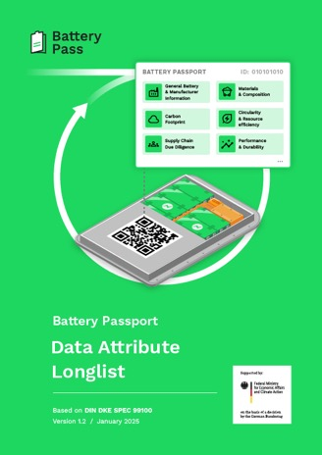
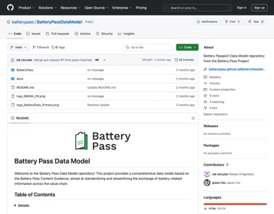
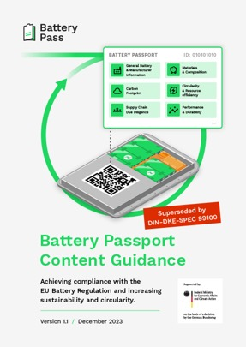
03 Find & Map Data
How did we translate BatReg Articles into Data Points and Systems?
Government Resources:
https://thebatterypass.eu
Data Attribute Longlist
Generic Data Model
A. Puzankova & S. Hoffmann I Practical Implementation Insights PowerCo I EU Battery Passport Conference

Slide 17




03 Find & Map Data
How did we translate BatReg Articles into Data Points and Systems?
Government Resources:
https://thebatterypass.eu
Data Attribute Longlist
Generic Data Model
Validation, Selection and Mapping of Data Points for different Products and Brands
Data Attribute Shortlist
Specific Data Models
A. Puzankova & S. Hoffmann I Practical Implementation Insights PowerCo I EU Battery Passport Conference

Slide 18

03 Find & Map Data
How did we translate BatReg Articles into Data Points and Systems?
Government Resources:
https://thebatterypass.eu
Data Attribute Longlist
Generic Data Model
Validation, Selection and Mapping of Data Points for different Products and Brands
Data Attribute Shortlist
Specific Data Models
Applying the Data Model to the Brand Specific IT Landscape
Relevant IT Systems
System and Data Owners
A. Puzankova & S. Hoffmann I Practical Implementation Insights PowerCo I EU Battery Passport Conference

Slide 19
03 From Regulations to Use Cases: PowerCo Tier Model
A layered approach helped us to identify relevant stakeholders, data, systems and use cases for the Battery Pass
EU Articles to Battery Pass IT System
EU Article
Art. 47 ff.
Domain
Data Attributes
IT Source Systems
IT System Customer
Art. 6
Art. 8 & 10
Art. 13
Art. 7
Art. 71 ff.
Procurement
Restricted Substances (R&D)
Recycled contend, material data (R&D)
Production
Carbon Footprint (Sustainability)
Recycling
Due Diligence Supply Chain Data
Restriction of substances
Material, performance and recycled content data
Production and logistics data
PCF
Circularity & resource efficiency data
Use Cases
Internal PowerCo IT Systems, Supply Chain Partner Systems
Customer IT Systems, Interfaces, VW Group Solution
Domain Specific Use Cases with Central Data Platform
A. Puzankova & S. Hoffmann I Practical Implementation Insights PowerCo I EU Battery Passport Conference

Slide 20
04 Practical Implementation Insights Battery Pass
PowerCo’s comprehensive 4 pillar journey of Battery Pass implementation
01
02
Structure & Organize
Understand Regulation
Build project governance, stakeholder alignment, and decision committees. Identify major player & decision-maker.
Identify applicable articles, attributes, and compliance scope for our products. What applies to us specifically.
03
04
Find & Map Data
Decide & Deliver
Locate required data across systems and establish ownership responsibilities. Data is everywhere and nowhere.
Determine technical architecture and execute implementation roadmap. Do I need a Battery Pass ?
A. Puzankova & S. Hoffmann I Practical Implementation Insights PowerCo I EU Battery Passport Conference

Slide 21
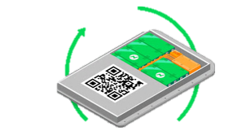

04 Decide & Deliver
How did we decide on an IT-Architecture and are delivering our Battery Passport Data?
Mining
Refining
Module/
Cell production
Module and system assembly
Vehicle production
OEM/ Group
Customer
2nd Life
Recycling
Other 2nd & 3rd Tier Suppliers
Static Data
Dynamic Data
Scenario 1: UFC
Know your role in the Supply Chain!
Regulation Requirements
Supplier Network
Customers
For our UFC we need to deliver Data to our Customer,
NOT a Battery Pass!
A. Puzankova & S. Hoffmann I Practical Implementation Insights PowerCo I EU Battery Passport Conference

Slide 22

04 Decide & Deliver
Multiple Products and Roles in the Supply Chain do affect your obligations massively!
Mining
Refining
Module/
Cell production
Module and system assembly
ESS production
Customer
2nd Life
Recycling
Other 2nd & 3rd Tier Suppliers
Static Data
Dynamic Data
Scenario 2: ESS
Know your role in the Supply Chain!
Regulation Requirements
Supplier Network
Customers
For our ESS we do need a Battery Pass!
A. Puzankova & S. Hoffmann I Practical Implementation Insights PowerCo I EU Battery Passport Conference

Slide 23
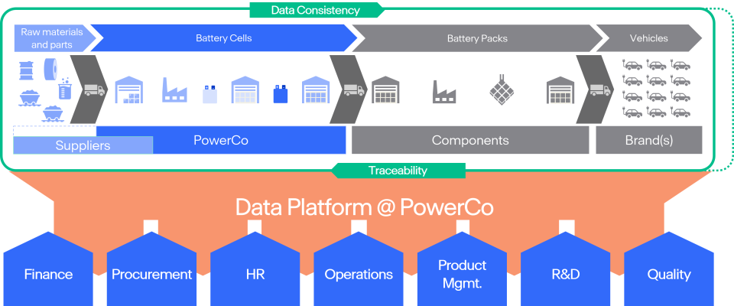
04 Decide & Deliver
Our Data Platform as the Backbone for a Data Driven Company
A. Puzankova & S. Hoffmann I Practical Implementation Insights PowerCo I EU Battery Passport Conference

Slide 24




04 Decide & Deliver: Architecture Big-Picture
We are maximizing Synergies to keep the financial impact of the Battery Pass as low as possible
Battery Passport - VW Group Solution
Battery Passport Backend
Battery Pass Frontend
Unified Cell
Data Platform
Battery Pass Frontend
End User & Consumers
Supply Chain Actors
Regulators & Policymakers
Energy Storage Systems (ESS)
A. Puzankova & S. Hoffmann I Practical Implementation Insights PowerCo I EU Battery Passport Conference

Slide 25
Challenges & Lessons Learned
01
02
Structure & Organize
Understand Regulation
Standardization / Lack of global standards
Resources, High costs
Different manufacturers, products, suppliers, and countries
Pending Delegated Acts
Moving Regulation Deadlines
Interpretation of Regulation
03
04
Find & Map Data
Decide & Deliver
                Identification of relevant data in the company and supply chain
                Data availability & responsibilities
Buy vs. Make
Supplier readiness
Data Platforms
Generation of own battery pass
A. Puzankova & S. Hoffmann I Practical Implementation Insights PowerCo I EU Battery Passport Conference
Notes:
and recycling pending delegated acts. Carbon Footprint & Due Diligence due dates have been postponed and further movements to be expected. Interpretation of Regulation in a lot of cases still unclear, especially regarding data to calculate the carbon footprint (data from production & logistics for example).

Slide 26


