Slide 1
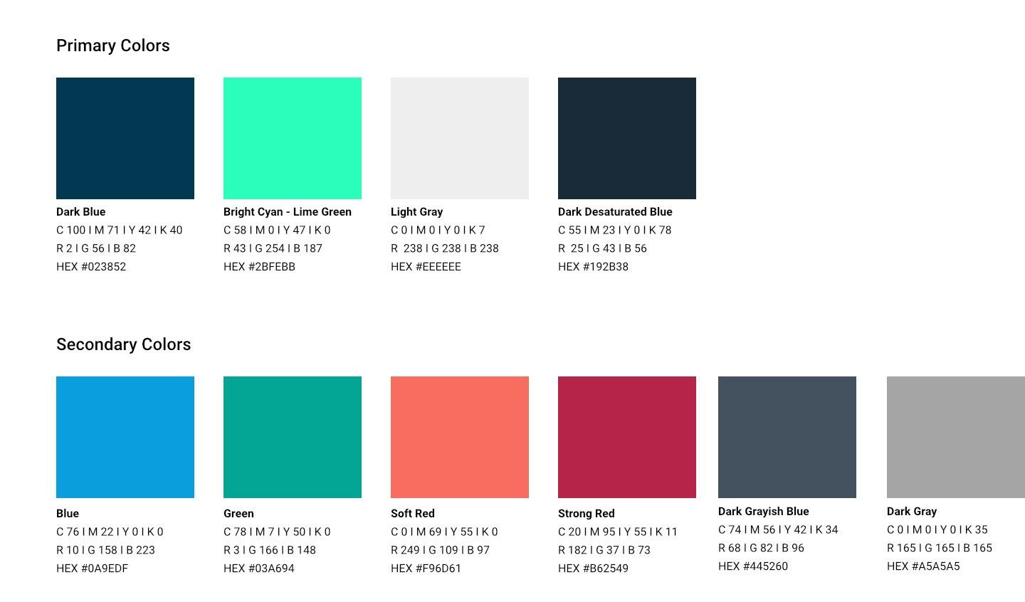


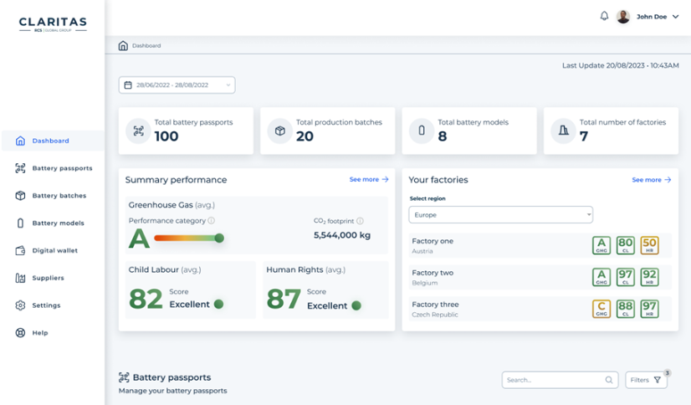

Beyond the pilot:
What we learnt deploying Battery Passports in Production
EU Battery Passport Conference 2026
Get Started

Slide 2




























Introduction
Spherity Ecosystem
Founded in 2017
Dortmund, Germany (HQ)
New York, USA
32 Employees
Offering:
Digital Wallet, Digital Product Passport, and Credentialing Solutions
Core Industries:
Life Sciences, Financial Services, Automotive, Manufacturing, Energy
Products
Enterprise Identity for US Pharma Industry
EU Business Wallet solutions
Digital Product Passport Solutions (DPP)
Customers
Partners
Certificates
Awards

Slide 3





Our Alignment with Standardisation
We are involved major ecosystem and standardisation activities
Tier-n – Upstream Supply Chain
Battery Components
PPAP
EO
Vehicle Owner Usage
Responsible Battery Take Back
Tier
n
…
3
2
1
DPP piloting, data access, no standardisation
JTC 24, DPP Technical Standardisation, Request Battery Passport System
DIN Spec, Norm Light, Data Semantics, DBP Basis for OEM)
DBP Content Guidance, Standardisation, Demonstrator
Customer Engagement
DBP/DPP Data Exchange, Protocol Standardisation, foundational SW
Business Models
Defining rules on how to add tracing information to the DPP
DBP Rules Books & Piloting

Slide 4
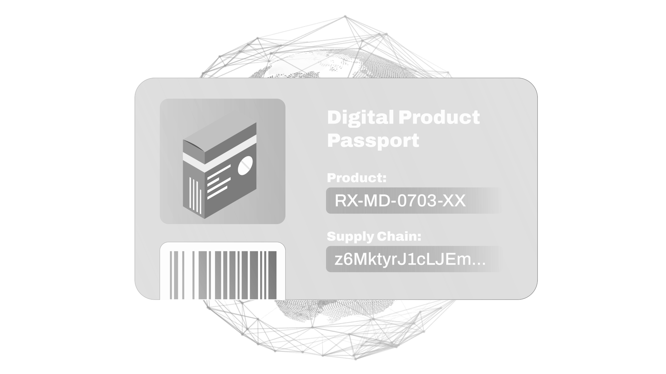




Beyond the pilot
Bridge the Gap Between Vision and Integration
Pilot assumes:
2027 deadline
ESPR, EU Battery Regulation
QR codes
and basic product information
Static & Manual Compliance
from fragmented systems
Carbon footprint
reporting
Notes:
Battery Passports have moved on.
The real challenge is no longer definition — it’s operation.
Passports are now live
Data is dynamic
Systems must work at scale

Slide 5


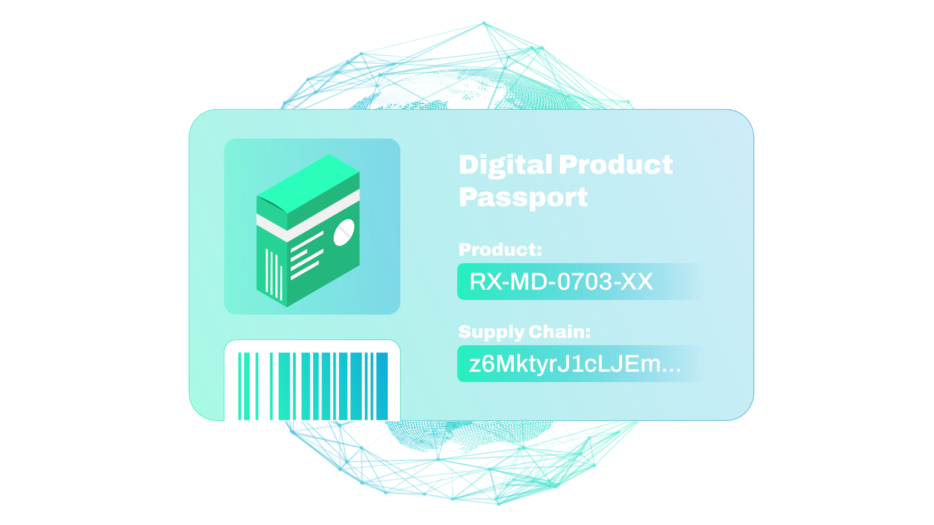


Beyond the pilot
Bridge the Gap Between Vision and Integration
Pilot assumes:
Reality demands:
2027 deadline
ESPR, EU Battery Regulation
Lifecycle updates
Dynamic, living passports
QR codes
and basic product information
VS.
Verifiable Credentials
for trust and security
Static & Manual Compliance
from fragmented systems
Integration & Automation
with ERP / MES / suppliers
Carbon footprint
reporting
Multiple lives & owners
Battery analytics
Second life / Resale value
Insurance
Notes:
Battery Passports have moved on.
The real challenge is no longer definition — it’s operation.
Passports are now live
Data is dynamic
Systems must work at scale

Slide 6



Every live DBP faces the same 3 problems
#1
#2
#3
Dynamic operational data
Enterprise data integration
Lifecycle transitions & circularity

Slide 7

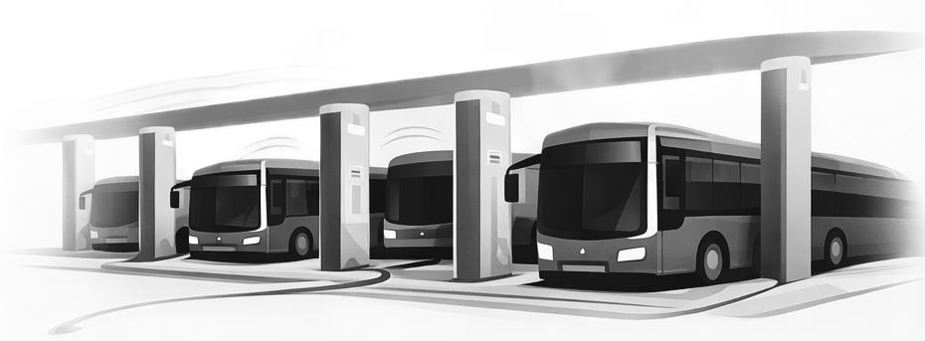
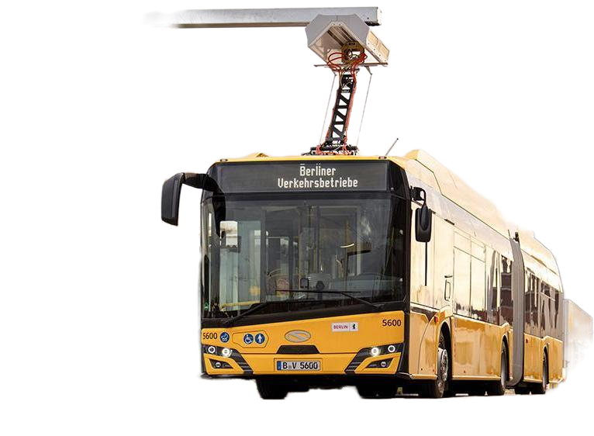

Live public transport fleet, batteries in daily operation
Use Case #1 — DBP as a Condition Monitoring System
Manufacturing
Commissioning
SoH
Operations
Events
Temperature
Maintenance
Core Challenges
Battery data doesn’t stop changing after commissioning
Static passports fail once operational data starts flowing
A Battery Passport must be a living system — not a certificate
Live today • Operational data • Continuous updates

Slide 8




Heavy-duty vehicles, existing data lakes, complex IT landscapes
Use Case #2 — DBP as a Data Orchestration Layer
MES
ERP
QA
Suppliers
ERP
QA
Suppliers
Recyclers
Recyclers
MES
Data lake
Core Challenges
Information scattered across ERP, MES, suppliers.
Lifecycle data needs continuous, automated updates.
Millions of batteries, secure sharing across partners.
Live deployments • OEM IT • No greenfield assumptions

Slide 9
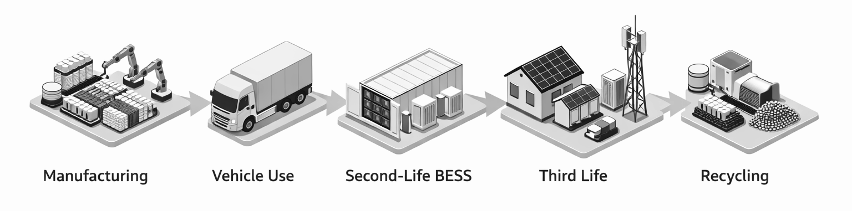
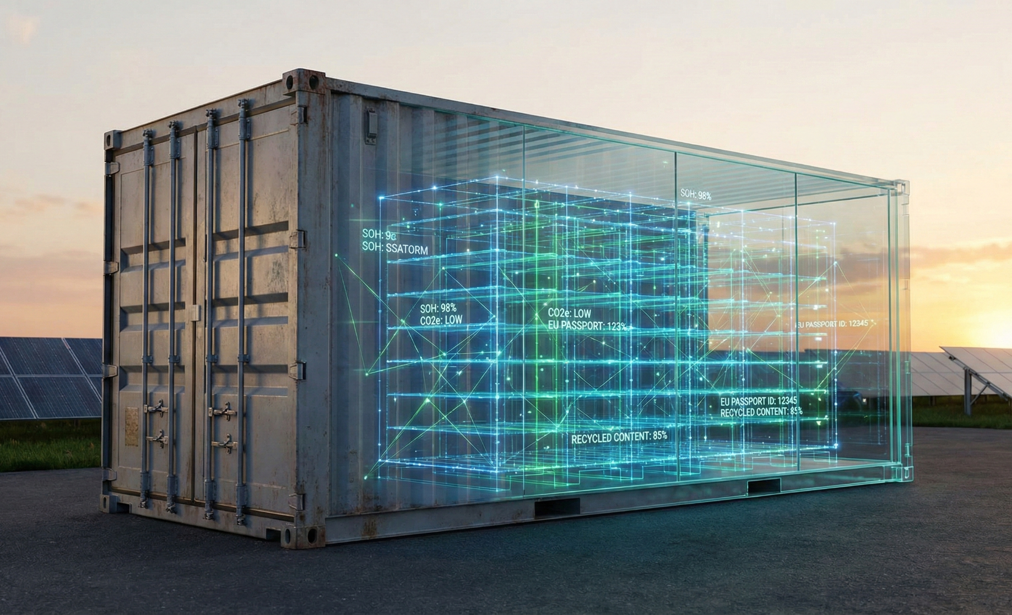
Truck batteries transitioning into stationary energy storage.
Use Case #3 — DBP as a Circularity Enabler
New owner, new use
Core Challenges
Ownership, use case, and regulation all change — trust must remain
Passports designed only for first life
Without a DBP, second life does not scale
Live second-life systems • Mobility → Energy • Asset continuity

Slide 10
What we learned by being live
#1
#2
#3
DBPs must behave like infrastructure
Readiness is proven only in production
Experience matters more than roadmaps
Insights drawn from multiple live deployments across mobility and energy

Slide 11
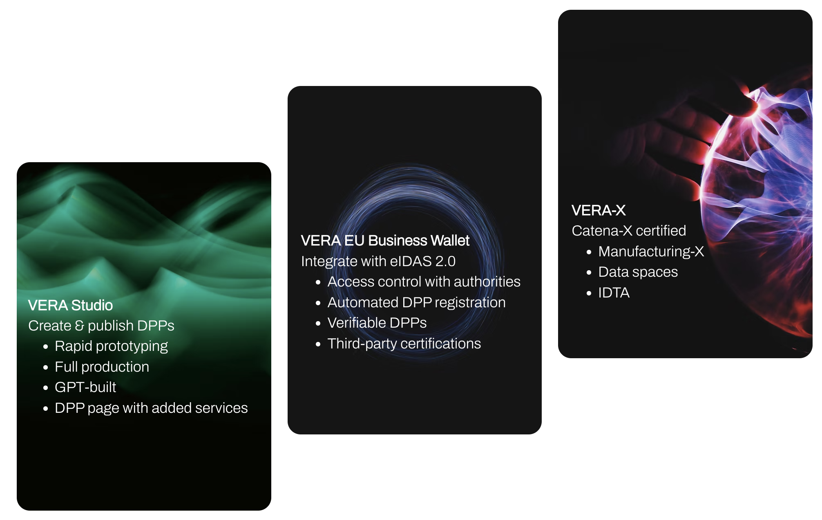


Spherity's modular ‘DPP Management System’
VERA Product Suite
Easy creation and publishing of DPPs on the Web with Seamless Integration into SSI-based Trust Ecosystems and Data Spaces
Catena-X -certified

Slide 12


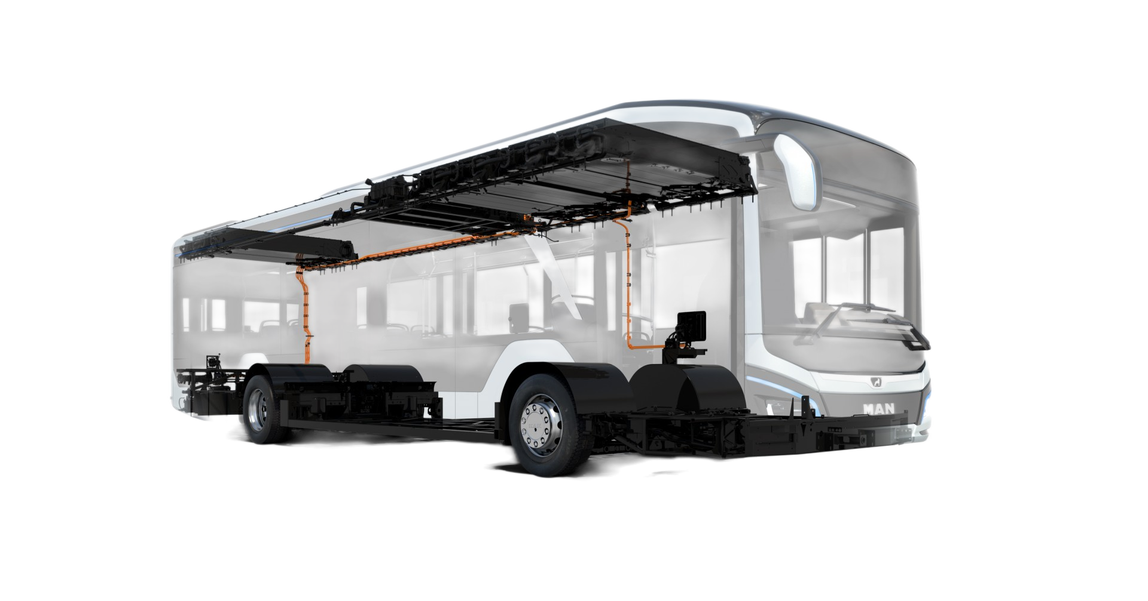


VERA’s Digital Product Passports
Unique ID & authentication
Deployment options
On premises and SaaS
QR code
Authenticity and origin
Custom domain hosting
for brand consistency
Model data & materials
Seamless API integration
with existing systems (e.g., SAP Ariba)
Product specification
Sustainability & transparency
White-labeling
with fully brandable interface
Batch & manufacturing info
Standalone solution with user-friendly interface
Seamless integration with flexible APIs
Traceability
Quality control
Ownership & Lifecycle
Signed W3C Credentials
Non-repudiation
EUDI Wallet comaptible
Standardized revocation mechanism
Signed W3C Credentials
Non-repudiation
EUDI Wallet compatible
Standardized revocation mechanism
Transfer of ownership
History & resale
Recycling options
Recycling and return programs
Circularity
Notes:
Solution: KYC / KYS / KYB → AML, CDD
Streamlined customer and supplier onboarding
Perpetual KYC monitoring with trigger events:
Email notifications
External system updates
Automated refresh
Automated KYC record refresh based on:
Periodic updates
Monitoring indications
Offer:
Deployment Options: On-premise or SaaS
Seamless Integration: APIs for existing systems (e.g., SAP Ariba)
Standalone Solution: User-friendly interface
Signed W3C Credentials:
Non-repudiation
EUDI Wallet readiness
Standardized revocation mechanism

Slide 13




What sets Spherity apart
Flexibility & Modularity
Modular, schema-driven architecture for custom DPP setups
DPPs already on the road
Solution already in production. Proven with customers like Solaris and other European manufacturers
Integration ready
Low configuration effort on the DPP solution side
EU Business
Wallet Integration
Ready for integration with the European Digital Identity Wallet (eIDAS 2.0)
Strategic partnerships in place
Digital Identity & Verifiability
Use of Decentralized Identifiers (DIDs) and Verifiable Credentials
In line with CIRPASS 2 blueprint

Slide 14


2027 is around the corner
Act Now to Lead the Digital Battery Economy
Get in touch
Giuseppe Benenati
Director Sales @Spherity
giuseppe.benenati@spherity.com
+39 329 6975485
www.spherity.com

